Slide 1
Mantid Scientific Steering Committee
Nick Draper
12/04/2009

Slide 2
Progress over the last iteration
SANS
  SANS User interface – 1st Draft
  Move masking details to be held per workspace
  2D Q Analysis
Diffraction
  Create grouping files
  Display grouping on the instrument view
  Point by point vanadium correction
  Diffraction output file format
Reflectometers
  Created Unary correction operations

Slide 3
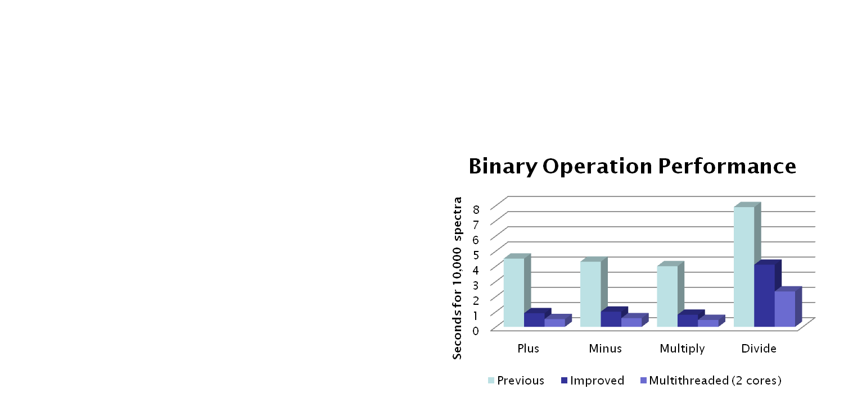
Progress over the last iteration
Performance
  LoadRaw file caching for remote drives
  Improved algorithm speed
    LoadDAE
    Cylinder attenuation correction
    Diffraction focussing
  Binary Operations
  Multi threaded execution

Slide 4
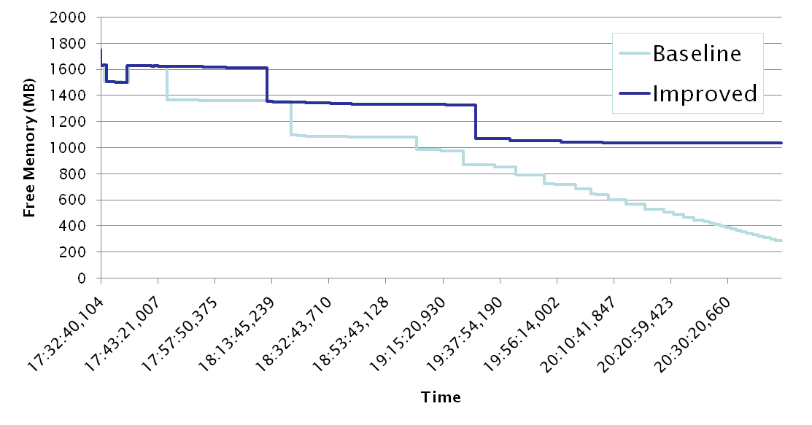
Progress over the last iteration
Memory Management
  Identified and fixed several memory leaks
  More stability and memory work still to do

Slide 5
Progress over the last iteration
User Interface
  Colour Map and image map graphing options
  Plot first spectrum
  Create Sample Shape user interface – 1st draft
  Display of Table Workspaces
  Log filtering changes
  1D graph plotting changes

Slide 6
Progress over the last iteration
Scripting
  Allow scripts to import scripts
  Improved interaction with Mantid Matrix windows
  Allow suggested parameter values in scripts
Distribution
  Red Hat Enterprise 5 RPM that works!

